Slide 1
TERm paper presentation
BITS F464: Machine Learning
Paper Title:
Nimble: Lightweight and Parallel GPU Task Scheduling for Deep Learning
Presented BY
2017A7PS0162P Shreyas Srikrishna
2017A7PS0145P Aniruddha Mahajan

Slide 2
Introduction
Advancement in modern DL frameworks like Tensorflow, PyTorch:
  Implementation of GPU-based neural-network computations
  Framework automatically handles GPU task scheduling and submission.
Inefficiencies suffered by these frameworks:
  Scheduling Overhead often dominates the running time of DL inference/training.
  Serial Execution of the GPU Tasks – misses opportunity to parallelize
    Existing DL frameworks are designed and optimized to submit GPU kernels to a single GPU stream.

Slide 3
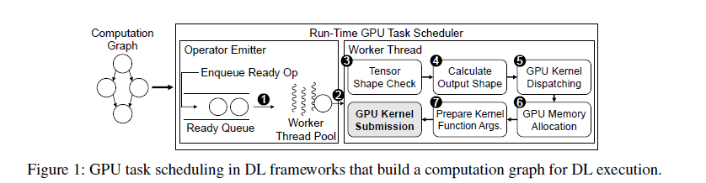
Background
GPU Task scheduling in existing frameworks like Tensorflow:
  These preparation steps in run-time scheduling happen repeatedly for each neural network execution.
  In case of static neural networks, DL Frameworks run the same computation graph with same input shapes repeatedly.
GPU Stream: A queue of GPU tasks scheduled sequentially in FIFO order.
  Not much scope for intra-kernel parallelism due to limitations in the kernel’s implementation and tensor shape/size. (eg: Batch-Normalization)
  Kernels on different streams can be computed parallelly. Yet, existing frameworks are designed to submit GPU Kernels to a single GPU stream.

Slide 4
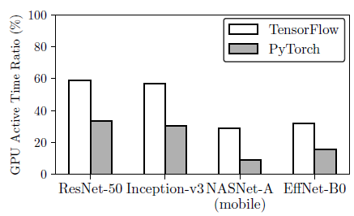
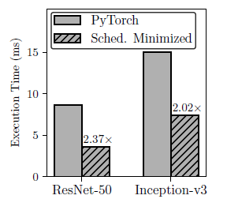
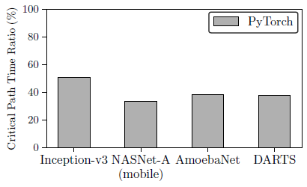
Motivation
  Idling in GPUs due to high scheduling overhead:
    Experiment to find out the ratio of GPU active time to overall running time spent on inference.
  Minimizing scheduling process for neural networks with fixed input shape:
    Experiment to perform inference on such networks -> C++ program with same GPU Kernels and memory operations as PyTorch but without tensor shape checks and memory allocation.
  Serial GPU task execution:
    Experiment to find out ratio of critical path time to total GPU active time in inference.
Notes:
1. Tensorflow and PyTorch leave their CPUs idle for up to 71% and 91% respectively during run-time.
2. 2.37x speedup in ResNet-50 and 2.02x speedup in Inception-v3 by the scheduling minimization.
3. Critical-Path-Time : Sum of GPU active times spent on operators in the longest path (in terms of time) in the computation graph.
=> Inference latency can be reduced by up to 3x when GPU tasks are fully parallelized and executed on a sufficiently powerful GPU (that can compute every kernel simultaneously)

Slide 5
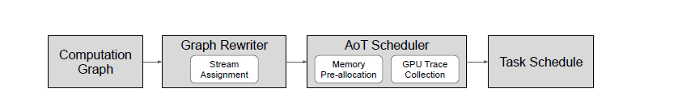
Solution: NimblE
System design of Nimble
Automatically avoid scheduling overhead of DL frameworks by performing:
  Ahead of Time Scheduling (AoT)
Automatically parallelize GPU tasks using multiple GPU streams
  Stream Assignment Algorithm

Slide 6
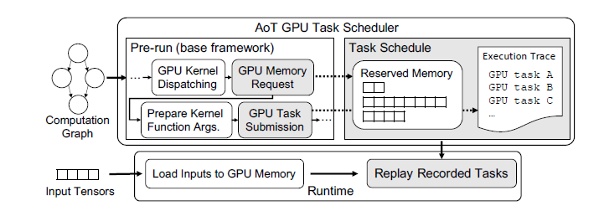
Ahead of Time Scheduling (AoT Scheduling)
Takes advantage of the following facts in a static neural network:
  Once the GPU tasks are determined, the scheduling procedure of DL frameworks becomes redundant.
  Same sequence of memory requests is made in each iteration.
Pre-run the neural network once to record all GPU tasks as an execution trace.
Intercept memory requests and reserve the GPU memory that was allocated in the pre-run.

Slide 7
Ahead of Time Scheduling (AoT Scheduling)
Takes advantage of the following facts in a static neural network:
  Once the GPU tasks are determined, the scheduling procedure of DL frameworks becomes redundant.
  Same sequence of memory requests is made in each iteration.
Pre-run the neural network once to record all GPU tasks as an execution trace.
Intercept memory requests and reserve the GPU memory that was allocated in the pre-run.

Slide 8
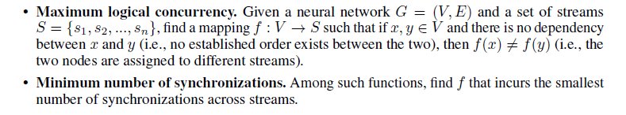
Stream Assignment Algorithm
  Goals of this algorithm:

Slide 9
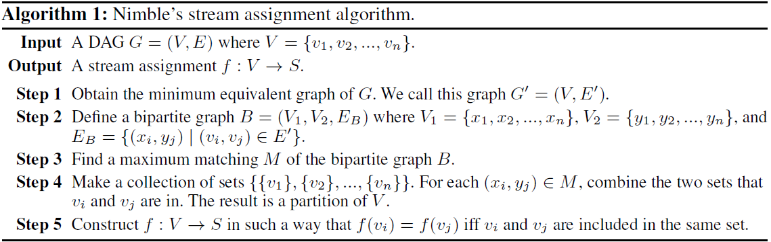
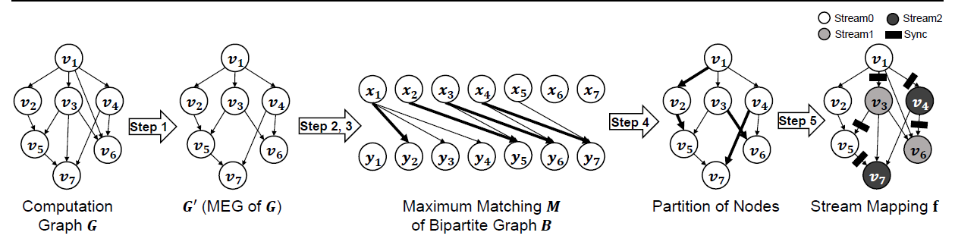
Stream Assignment Algorithm

Slide 10
Evaluations and results
For evaluation, authors have used an NVIDIA V100 GPU along with 2.10GHz Intel Xeon CPU E5-2695 v4.
The neural networks used are ResNet-50, ResNet-101, Inception-v3, NASNet-A, MobileNetV2, EfficientNet B0 and EfficientNet B5.
To evaluate DL inference, Nimble is compared with popular DL frameworks such as Tensorflow, PyTorch etc, as well as TensorRT (v7.1) and TVM (v0.6.1).
Whereas to evaluate DL training, Nimble is compared with PyTorch and TorchScript.

Slide 11

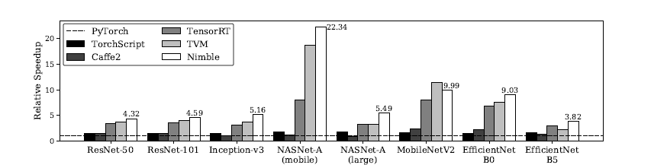
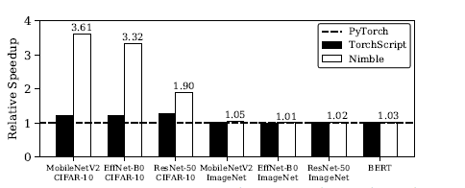
Relative inference speedup of Nimble with respect to other inference systems.
Relative training speedup of Nimble with respect to PyTorch and TorchScript.

Slide 12
Conclusion
The paper introduces Nimble, a high-speed DL execution engine for static neural networks.
Nimble addresses 2 main problems of run-time GPU task scheduling in current DL frameworks – scheduling overhead, serial execution.
Nimble reduces scheduling overhead by finishing the scheduling procedure ahead-of-time. It also schedules independent GPU tasks to be executed in parallel, thus providing significant speedup.
Evaluation of Nimble on various neural networks shows that it out-performs popular DL frameworks like Tensorflow and PyTorch.

Slide 13
THANK YOU

Slide 14
